Slide 1




Collaborating for
Community Success
Building & Leveraging Your Municipal Relationships
Teresa Schmidt
Public Library Administration Consultant
Wisconsin DPI Bureau of Libraries
Kami Lynch
Municipal Clerk Specialist
UW-Extension - Local Government Education
In partnership with
Leah Langby
IFLS Library System

Slide 2

Components for Consideration
Building & Leveraging Municipal Relationships
Key Topics
Structural & Operational Differences
  Funding
  Functionalities
Common Pain Points
Relationship Building
Success Stories

Slide 3
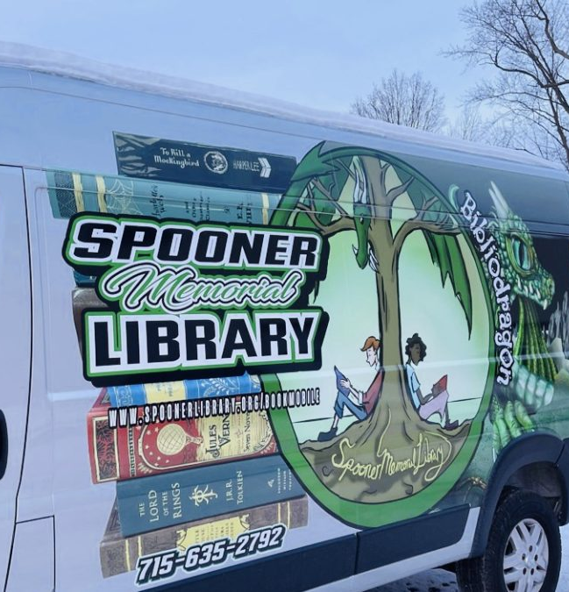
Strong relationships do exist!
Racine Public Library
  Helped with grant writing for a successful parks department project that the library now co-sponsors.
  Library staff serves on city-wide committees.
  Actively meets with city partners
Spooner Memorial Library
  Increased county reimbursements to 100%; county now provides funding for bookmobile staffing and feels a much greater investment in that project
Schreiner Memorial Library, Lancaster
  Provided tech training for municipal works staff: Excel, map & inventory programs, calendar.
  Saved the municipality money, improved their working relationships dramatically.

Slide 4

Areas of Friction:
Structural & Operational Differences

Slide 5
Structural Differences
Municipal Libraries
Joint Libraries
Consolidated County Libraries
Tribal libraries, city/county, county library service, etc.
Different library structures have different levels of engagement with municipalities.
What remains constant is the need for engagement by interest holders - municipalities and their residents (the library patrons).

Slide 6
Funding Differences
Municipal Budgets
Comprised of various funds.
Set by the tax levy, subject to levy limits.
Council/Board determines how money is allocated & spent
Municipalities/counties allocate funds to the library – but libraries determine how those funds are spent for library use.
Library Board Powers
Wis. Stat. Chapter 43
Library board determines use of all funds allocated for the library.
Library maintains a separate fund balance: Once allocated, library funds may not be returned to the municipality's general fund.
Library board retains control of gifts and donations.

Slide 7
Library Funding
Library Structure | Primary Funding | Operational Characteristics
Municipal Library | City, Village or Town property taxes | Public library board; department/branch of the municipality
Consolidated County Library | County tax levy | County library board; department of the county
Joint Library | Shared between 2+ Municipalities | Fiscal agent; Agreement on how to allocate funding between partners

Slide 8
Board differences
Municipal Board
Elected board
Terms vary – 1 year or 2 year
Clerk/Treasurer
  Elected separate positions
  Appointed positions
  Combined appointed position
Library Board
Appointed by municipal/county board
3-year terms
School representative
Up to 2 nonresidents
May have additional county appointees

Slide 9
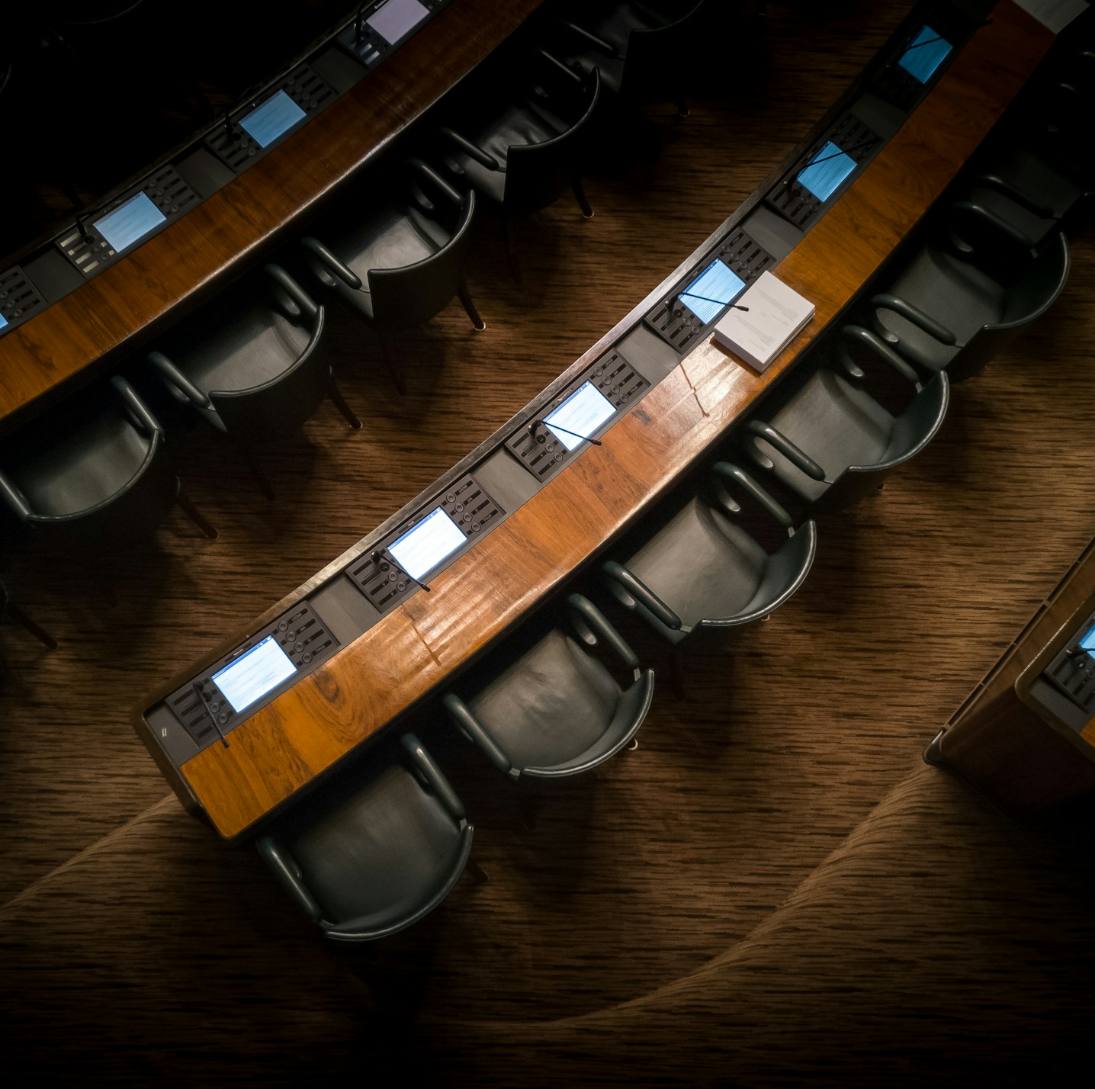
Library Board Appointments
Library board members appointed for 3-year terms.
County appointments and Municipal appointments are not necessarily aligned.
Appointing authority is the municipality or county, but library director is often the person keeping track of appointments.

Slide 10
Understanding Varied Roles
Library Director
Hired by the library board
Assists with library board business
Appoints and manages library staff
Directs all operations of the library
  Collections, programs, services, outreach
Develops library budget
Develops policies and procedures
Manages library facility needs
Strategic planning
Other duties as assigned!
Municipal Clerk
Elected or appointed
Legal Notices & Open Meetings
Records Management (info hub)
Elections
Licensing
Community Liaison
Governance Guardians
Possibly supervised by city/village administrator
All other duties as assigned…
or stumbled upon, or thrown into

Slide 11
Operational Differences
Facilities
  Leased v. owned
  Maintenance & care of building – shared or isolated
Operating hours
  M-F v. evenings & weekends
  Service operation support differences
Personnel
  Part-time & Full-time ratio
  Varying knowledge base

Slide 12
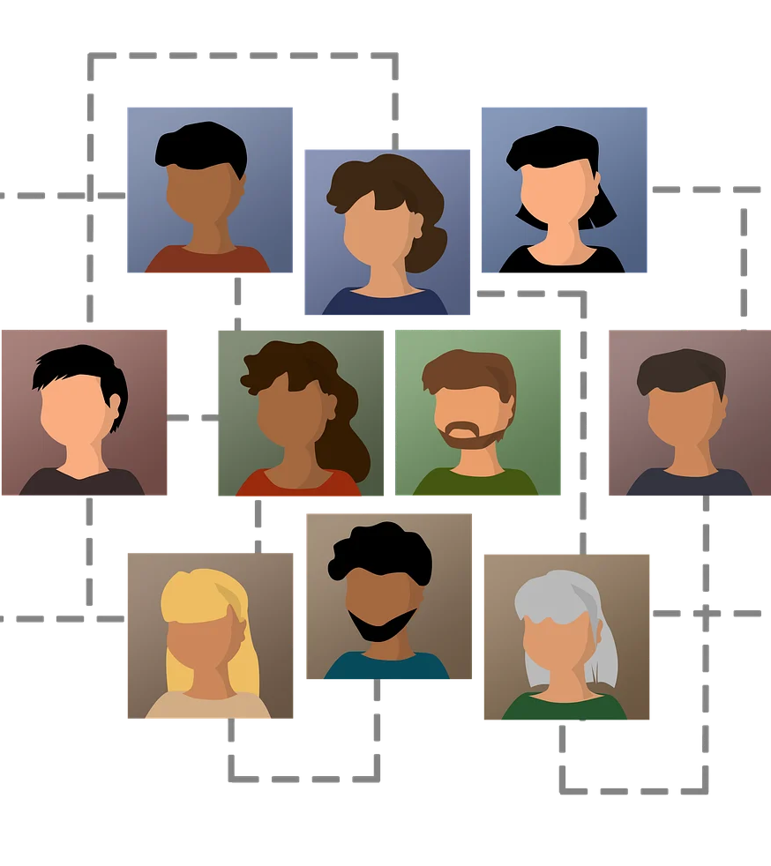
HR Differences
Personnel/Staffing
Large amount of part-time staff
Varying pay/compensation
Library Board authority to provide pay increases (*based on municipally allocated funds)
Lack of legal clarity: differing opinions from DPI and LWM on what defines “compensation” for library employees

Slide 13
Library Operations Evolve Quickly
Libraries fill voids in the community and offer services based upon relevant needs.
Needs are constantly evolving.
Libraries pivot and support these needs, often without allocated funding to do so.
Examples of services libraries currently provide:
  Social services work
  Job Center services
  Digital resources and learning
  Community meeting and work space
  In addition to "traditional" library services: access to information, early literacy programming, resources for lifelong learning, etc.

Slide 14
Differences = Pain Points
Lack of operational continuity can create lack of understanding, leading to:
Communication gaps
Misalignment of resources
Varying priorities

Slide 15

Building Relationships: the solution for pain points
Photo by Erika Fletcher on Unsplash

Slide 16

Relationships
Generate understanding
Promote collaboration
Ensure continuity during times of turbulence
Promote knowledge transfer
Creates a strong culture
(we vs. me)
Photo by Shunya Koide on Unsplash

Slide 17
Getting & Staying Involved
Relationships form through interaction and involvement.
Involvement builds a foundation of understanding and coordinated action.
Dissemination of needs by the municipality and the library = united efforts and partnerships.
Attend municipal leadership team meetings.
Be part of the budget process with other municipal departments.
Attend meetings of the local governing body – get to know your elected officials.
Speak up – communicate your needs AND wants.

Slide 18

Working together in municipalities
Strategic Planning
How the work of the library supports the municipality
Economic impact of libraries on the community
How dollars spent on the library flow back into the municipality
Operational Support
Libraries step in during times of need for the municipality, and vice-versa.
Onboarding and working with new staff members – Village of Cameron Public Library & Village of Colfax
Resource hubs for municipal happenings – property assessment or tax information, elections, comprehensive plan updates

Slide 19
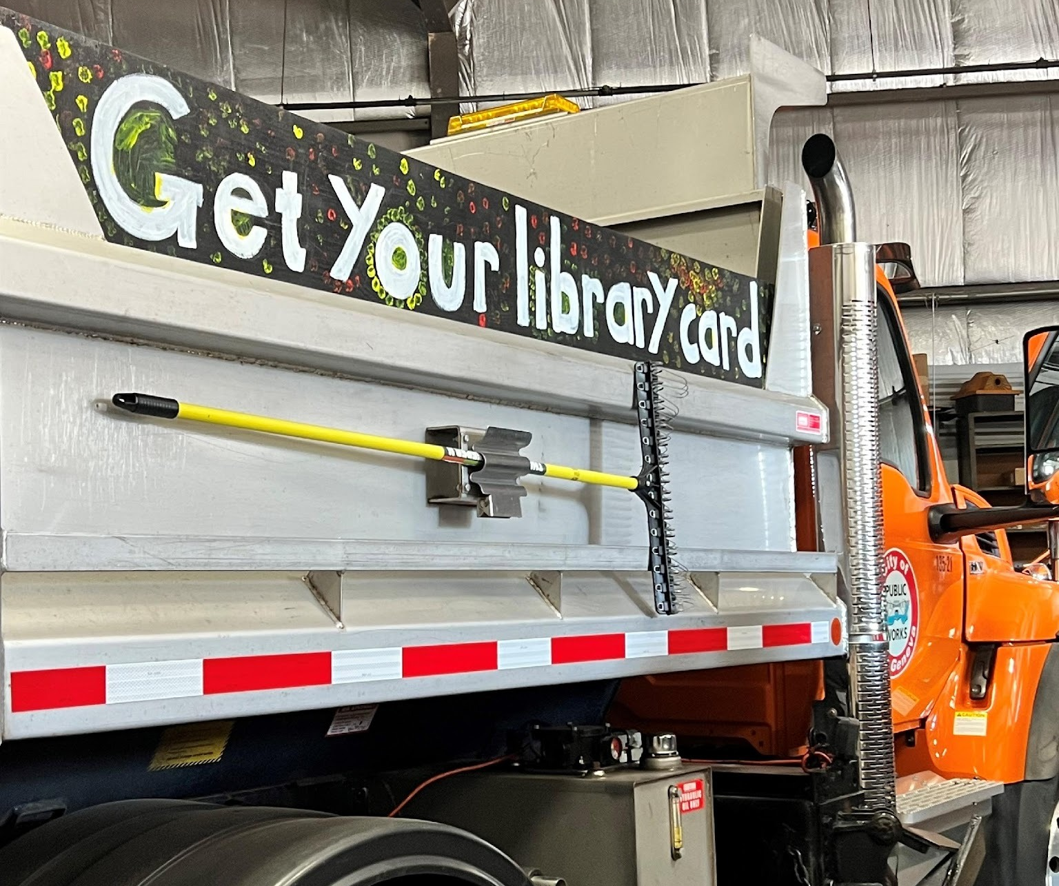
Supporting One Another: unique collaborations
Photo by Erika Fletcher on Unsplash
Photo by Lake Geneva Public Library

Slide 20
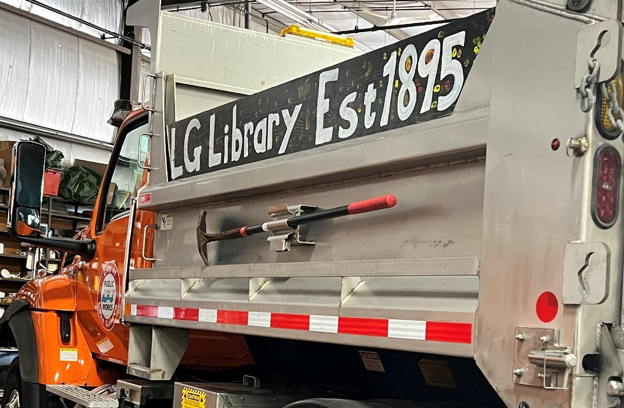
Unique Collaborations
City of Kaukauna & Kaukauna Library
  Cross-functional leadership team
  Library is Sunshine Committee for the City
Lake Geneva Building & Maintenance Support
  Grass-cutting, snow removal, coordination of delayed openings
  Advertise the Library on DPW trucks
  Library helps provide community information through panel events with the police chief, fire chief, city administrator, etc.
Collaborative programming
  Sheboygan Poet Laureate program with the mayor's office
  Collaborative programming with Rec Department

Slide 21
Ongoing Administrative Collaboration
Appleton Public Library
  "Consistent transparency, clear communication about the library's role, and a conscious effort to engage without defensiveness (on both sides)"
Somerset Public Library
  Regular department head meetings lead to collaborative budget work
  "It creates a respectful, collaborative process rather than one where departments feel pitted against each other for funding."
"Trust each other's expertise and judgment,
and lean on each other's strengths."
- Dwight Foster Public Library, Fort Atkinson

Slide 22

More Collaborations
Mukwonago Community Library
  Collaborative rain garden project
  Library welcome bags distributed at meter changes
New Berlin
  New city employees get a library card and library info during onboarding
  Invites road crew to use the library restrooms and as a warming center
  Engaged in city emergency management
Photo by Mukwonago Community Library

Slide 23
Upcoming Events
  Collaborating for Community Success: Leveraging your Library Relationships (geared toward municipal officials)
  Thursday, June 18th at 2:00 p.m. | REGISTER
  Collaborating for Community Success: Understanding Library Authority under
  Wis. Stat. Chapter 43
  William Oemichen, JD, Local Government Law Educator
  Thursday, July 16th at 2:00 p.m. | Registration info coming soon.
  Trustee Training Week: “All Playing in the Same Orchestra”
  Thursday, August 13th at 12:00 p.m. | REGISTER
  …and more to be announced

Slide 24

Thank you!
Teresa Schmidt
Public Library Administration Consultant
Wisconsin DPI Bureau of Libraries
teresa.schmidt@dpi.wi.gov
Kami Lynch
Municipal Clerk Specialist
UW-Extension - Local Government Education
kami.lynch@wisc.edu
Leah Langby
Library Development and Youth Services Coordinator
IFLS Library System
langby@ifls.lib.wi.us
Photo by Dongsh on Unsplash

