Slide 1




Collaborating for
Community Success
Building & Leveraging Your Library Relationships
Teresa Schmidt
Public Library Administration Consultant
Wisconsin DPI Bureau of Libraries
Kami Lynch
Municipal Clerk Specialist
UW-Extension - Local Government Education
In partnership with
Leah Langby
IFLS Library System
Notes:
TERESA
(self-intros)

Slide 2

Components for Consideration
Building & Leveraging Library Relationships
Key Topics
Structural & Operational Differences
  Funding
  Functionalities
Common Pain Points
Relationship Building
Success Stories
Notes:
KAMI

Slide 3
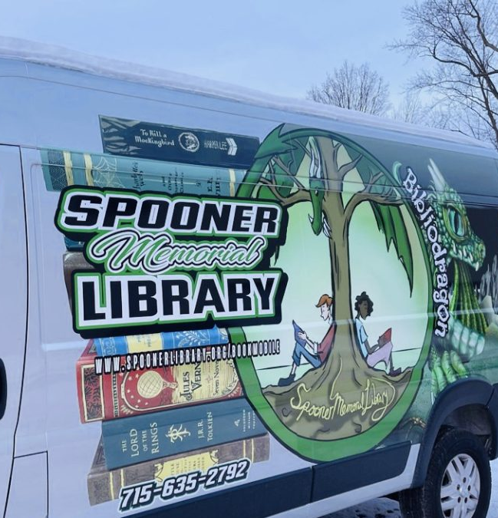
Strong relationships do exist!
Racine Public Library
  Helped with grant writing for a successful parks department project that the library now co-sponsors.
  Library staff serves on city-wide committees.
  Actively meets with city partners
Appleton Public Library
  Library staff helped to support elections and voting – COVID-19 Pandemic
Schreiner Memorial Library, Lancaster
  Provided tech training for municipal works staff: Excel, map & inventory programs, calendar.
  Saved the municipality money, improved their working relationships dramatically.
Notes:
TERESA
Start out with a couple of short examples of positive relationships – This is what we are aiming for!
Schreiner Memorial Library in Lancaster
Provided technology training for public works staff
Excel, map and inventory programs, calendar system
Saved public works money
Improved relationship exponentially: happier to help library with events, upkeep, etc.
Public Works head advocated for library
Example I removed:
Spooner Memorial Library
Increased county reimbursements to 100%; county now provides funding for bookmobile staffing and feels a much greater investment in that project
Colfax Public Library
Attends village board meetings quarterly to provide library updates, including a 1-page handout
Helped village and area organizations with grant writing

Slide 4
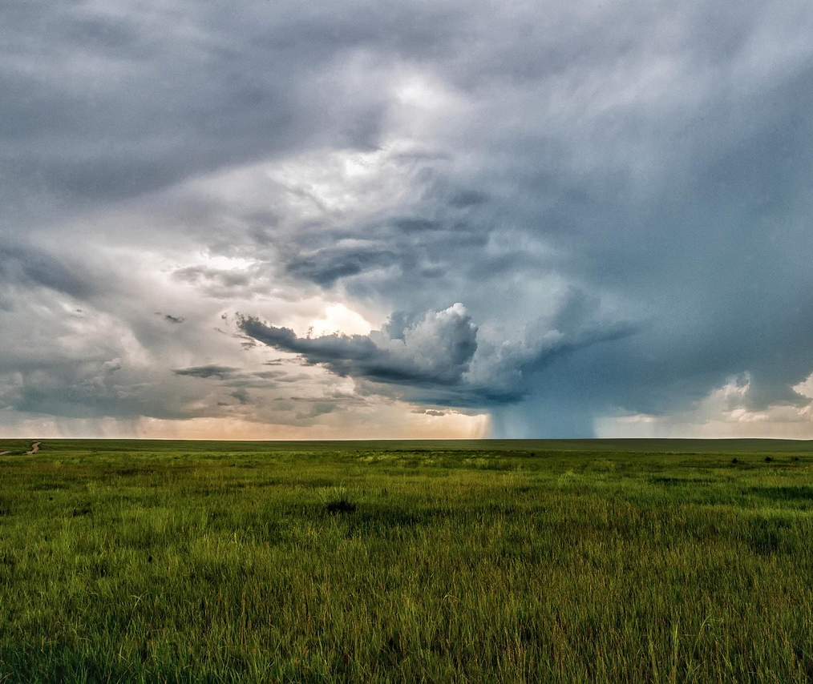
Areas of Friction:
Structural & Operational Differences
Areas of Friction:
Structural & Operational Differences
Notes:
KAMI

Slide 5
Structural Differences
Municipal Libraries
Joint Libraries
Consolidated County Libraries
Tribal libraries, city/county, county library service, etc.
Different library structures have different levels of engagement with municipalities.
What remains constant is the need for engagement by interest holders - municipalities and their residents (the library patrons).
Notes:
KAMI
Identify your library structure and know who to connect with for library information and involvement.

Slide 6
Funding Differences
Municipal Budgets
Comprised of various funds.
Set by the tax levy, subject to levy limits.
Governing body determines how money is allocated & spent.
Municipalities/counties allocate funds to the library – but libraries determine how those funds are spent for library use.
Library Board Powers
Wis. Stat. Chapter 43
Library board determines use of all funds allocated for the library.
Library maintains a separate fund balance: Once allocated, library funds may not be returned to the municipality's general fund.
Library board retains control of gifts and donations.
Notes:
KAMI
Municipal Funds are comprised of – talking point:
General Fund from property taxes, state aids & shared revenue (majority of budget)
- Special revenue funds – legal restrictions for use (grants, room taxes)
- planning funds
- Internal service funds- one department provides services to another
Enterprise funds – user service fees (utilities, parking)
Capital Improvement funds – high dollar long-range des to another (cost-reimbursement)
Reserve funds – fund balance
Debt-service funds resources and finances to pay off debt
Library funding not
TERESA
Here's how library funding fits in

Slide 7
Library Funding
Library Structure | Primary Funding | Operational Characteristics
Municipal Library | City, Village or Town property taxes | Public library board; department/branch of the municipality
Consolidated County Library | County tax levy | County library board; department of the county
Joint Library | Shared between 2+ Municipalities | Fiscal agent; Agreement on how to allocate funding between partners
Notes:
TERESA

Slide 8
Board differences
Municipal Board
Elected board/council
Terms vary: 2-year average
Mayors/Presidents: 4-year average
Clerk/Treasurer
  Elected or Appointed positions
  Combined or Separate positions
Library Board
Appointed by municipal/county board
3-year terms
School representative
Up to 2 nonresidents
May have additional county appointees
Notes:
KAMI
Describe general makeup of municipal board, variations in how clerk/treasurer positions are determined
TERESA
Very different for library boards!

Slide 9
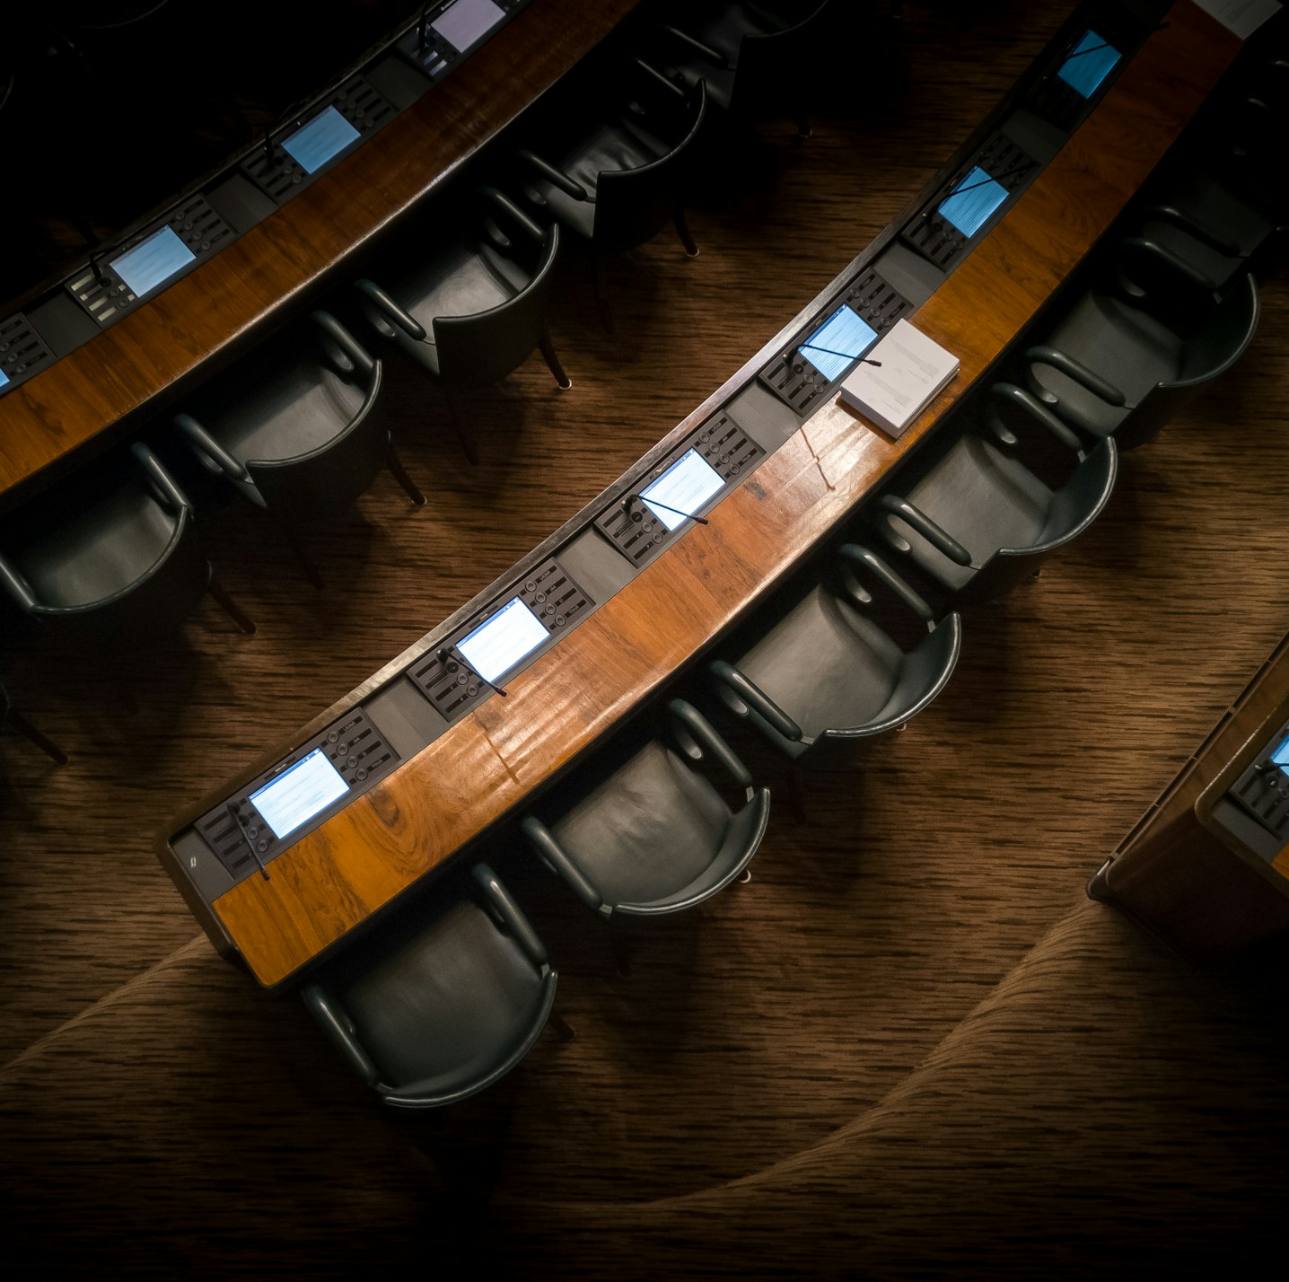
Library Board Appointments
Library board members appointed for 3-year terms.
County appointments and Municipal appointments are not necessarily aligned.
Appointing authority is the municipality or county, but library director is often the person keeping track of appointments.
Notes:
TERESA
Appointments of library board members can be another friction point between the library and municipality –
If you noticed on the last slide,
Add about municipal board/council non-voting member appointees from municipalities

Slide 10
Understanding Varied Roles
Library Director
Hired by the library board
Assists with library board business
Appoints and manages library staff
Directs all operations of the library
  Collections, programs, services, outreach
Develops library budget
Develops policies and procedures
Manages library facility needs
Strategic planning
Other duties as assigned!
Municipal Clerk
Elected or appointed
Legal Notices & Open Meetings
Records Management (info hub)
Elections
Licensing
Community Liaison
Governance Guardians
Possibly supervised by city/village administrator
All other duties as assigned…
or stumbled upon, or thrown into
Notes:
TERESA- Lib Dir
KAMI – Clerk
Typical job duties/responsibilities of library director and municipal clerk – "Other duties as assigned (or stumbled upon or thrown into)"
Understanding how the varied (and busy!) roles of each affects time and capacity for collaboration.
A big similarity: "Other duties as assigned"
The roles of library director and clerk vary by municipality or county, often depending on the size of the municipality, capacity of other municipal staff, strengths and skills of the individual who fills the role (which can cause extra tension during position turnover), etc.
Another big similarity: Both positions are often overworked and under-resourced!

Slide 11
Operational Differences
Facilities
  Leased v. owned
  Maintenance & care of building – shared or isolated
Operating hours
  M-F v. evenings & weekends
  Service operation support differences
Personnel
  Part-time & Full-time ratio
  Varying knowledge base
Notes:
KAMI
Service operation support – the types services being offered and their unique components vary greatly between libraries and municipalities – think library programming, the specific individuals working/involved to support those programs, the components required to make them enticing and run smoothly.
Municipalities don’t do a lot of programming – their duties are more aligned with statutory requirements. Differences is the design of spaces themselves – libraries = inviting, municipalities = less than inviting.
The audience served may be the same (community members) but they are there for vastly different reasons: Municipalities: because they don’t like something, Libraries: because they are interested in the program about monarch butterflies

Slide 12
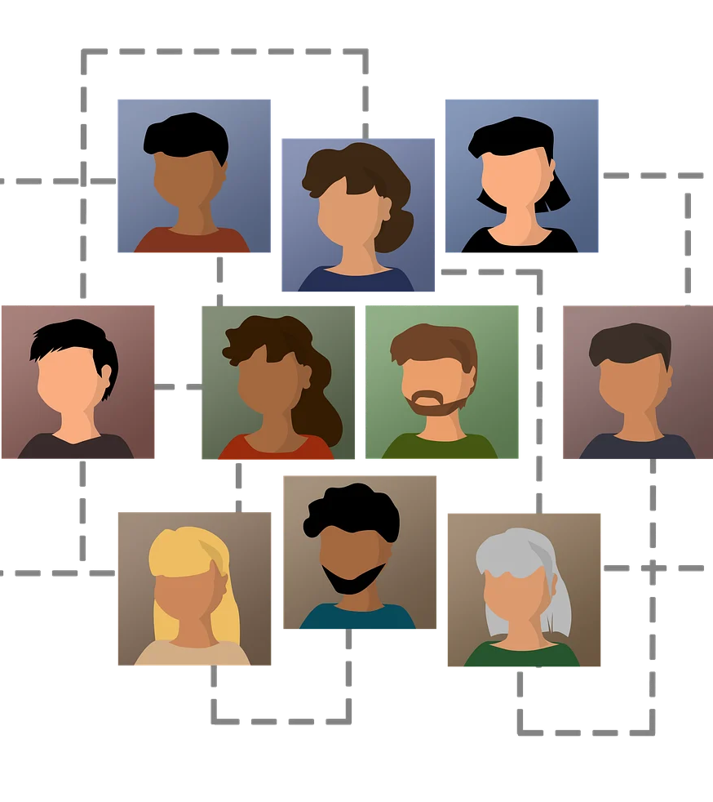
HR Differences
Personnel/Staffing
Large amount of part-time staff
Varying pay/compensation
Library Board authority to provide pay increases (*based on municipally allocated funds)
Lack of legal clarity: differing legal opinions on what defines “compensation” for library employees
Notes:
TERESA
Different knowledge and preferences between different sized municipalities: larger munis want more consistency in employee handbook. Generally will have an HR person with more expertise and resources.
Lack of legal clarity – differing advice from DPI and LWM about what defines "compensation" for library employees, which is controlled by the library board under 43.58(4)

Slide 13
Library Operations Evolve Quickly
Libraries fill voids in the community and offer services based upon relevant needs.
Needs are constantly evolving.
Libraries pivot and support these needs, often without allocated funding to do so.
Examples of services libraries currently provide:
  Social services work
  Job Center services
  Digital resources and learning
  Community meeting and work space
  In addition to "traditional" library services: access to information, early literacy programming, resources for lifelong learning, etc.
Notes:
TERESA
Another thing that has affected library/municipal relationships in recent years is the rapid pace at which library services have evolved. Factors like the pandemic, digital evolution, increasing need for social services and lack of resources for social service agencies – all have changed the day-to-day work of libraries!

Slide 14
Differences = Pain Points
Lack of operational continuity can create lack of understanding, leading to:
Communication gaps
Misalignment of resources
Varying priorities
Notes:
KAMI
Connect these to previous slides and Transition to the next section on building relationships
Ownership confusion = misunderstanding & finger pointing, assumptions about who is doing something (or not doing something)

Slide 15

Building Relationships: the solution for pain points
Photo by Erika Fletcher on Unsplash
Notes:
KAMI
Close the loop on these disparities and areas of confusion through active involvement.

Slide 16

Relationships
Generate understanding
Promote collaboration
Ensure continuity during times of turbulence
Promote knowledge transfer
Creates a strong culture
(we vs. me)
Photo by Shunya Koide on Unsplash
Notes:
TERESA

Slide 17
Involvement:
Keeping the Door Open
Relationships form through interaction and involvement.
Involvement builds a foundation of understanding and coordinated action.
Dissemination of needs by the municipality and the library = united efforts and partnerships.
Library Directors should have a place in municipal leadership team meetings.
Libraries are part of the budget process with other municipal departments.
Attendance at municipal board/council meetings: library updates.
Coordinated projects and roles. How can the library help?
Notes:
KAMI
Incident response plans – municipal presentation – coordinated responses and resources
The library is the community hub for happenings – leverage this to communicate information to constituents.
Libraries host many informational & educational offerings – listening sessions for your budget, local candidate panel discussions, open house for major road projects
Provide examples:
Amery and Appleton – seat at the table at municipal council meetings

Slide 18

Working together in municipalities
Strategic Planning
How the work of the library supports the municipality
Economic impact of libraries on the community
How dollars spent on the library flow back into the municipality
Operational Support
Libraries step in during times of need for the municipality, and vice-versa.
Onboarding and working with new staff members – Village of Cameron Public Library & Village of Colfax
Resource hubs for municipal happenings – property assessment or tax information, elections, comprehensive plan updates
Notes:
TERESA
(Note: renamed this slide from “Library director roles in the community”)
Consistency of messaging on municipal and library projects – Share information, resources, promotional items about projects so all are on the same page and sharing similar messages.
Stepping in during times of need:
In Colfax, the municipality has stepped in to provide assistance after the untimely death of the library director.
In Cameron, NEW municipal clerk and court clerk didn’t have any other staff and needed lots of clear-up and correction. Library director offered administrative assistance to help out until they could get caught up and get offices staffed.

Slide 19
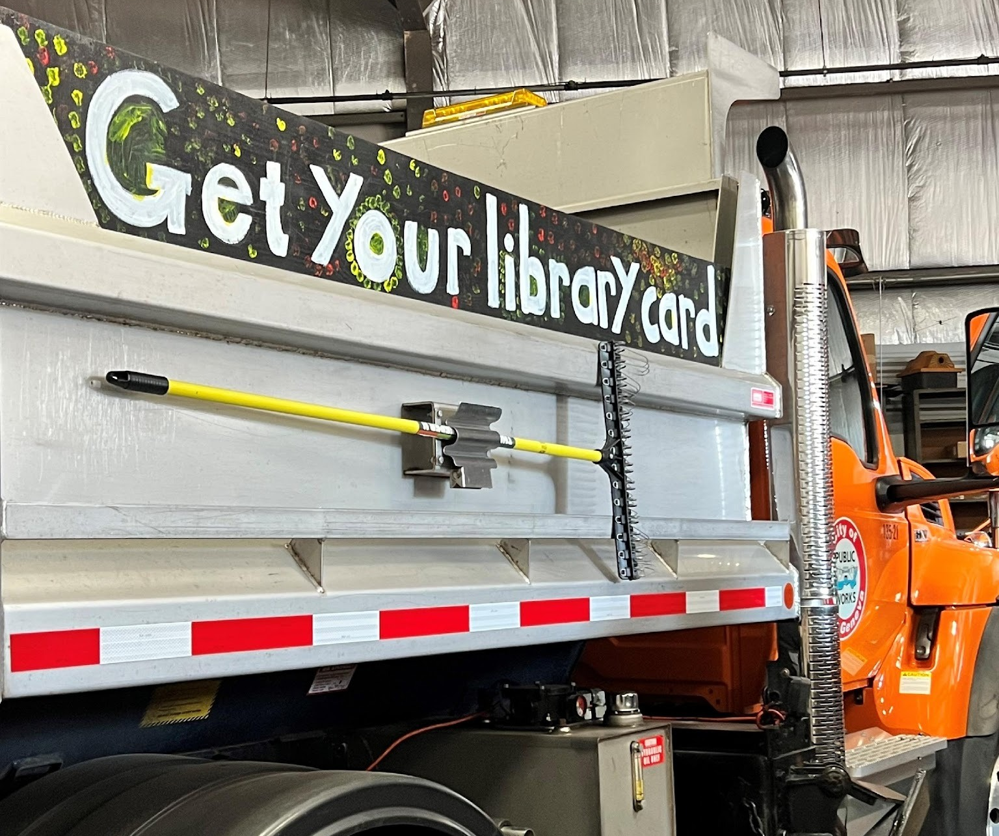
Supporting One Another: unique collaborations
Photo by Erika Fletcher on Unsplash
Photo by Lake Geneva Public Library

Slide 20
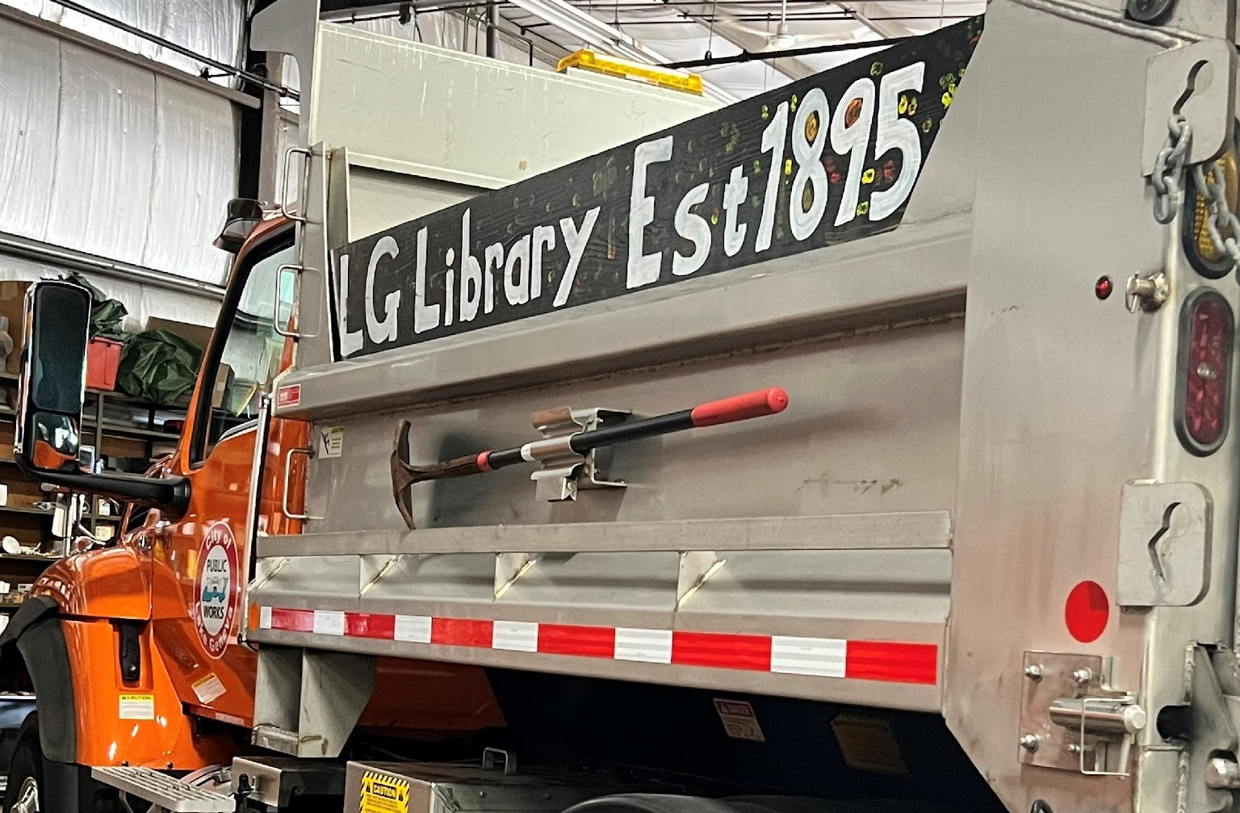
Unique Collaborations
City of Kaukauna & Kaukauna Library
  Cross-functional leadership team
  Library is Sunshine Committee for the City
Lake Geneva Building & Maintenance Support
  Grass-cutting, snow removal, coordination of delayed openings
  Advertise the Library on DPW trucks
  Library helps provide community information through panel events with the police chief, fire chief, city administrator, etc.
Collaborative programming
  Sheboygan Poet Laureate program with the mayor's office
  Collaborative programming with Rec Department
Notes:
KAMI
Collab programming examples:
Poet Laureate promotes Sidewalk Poetry program.
Working with the Rec Department
New Berlin provides reading lists for the Rec Dept owl walk; space for chair yoga
Fontana shares programs with the rec department to expand audiences and efficiently utilize paid performers

Slide 21
Ongoing Administrative Collaboration
Appleton Public Library
  "Consistent transparency, clear communication about the library's role, and a conscious effort to engage without defensiveness (on both sides)"
Somerset Public Library
  Regular department head meetings lead to collaborative budget work
  "It creates a respectful, collaborative process rather than one where departments feel pitted against each other for funding."
"Trust each other's expertise and judgment,
and lean on each other's strengths."
- Dwight Foster Public Library, Fort Atkinson
Notes:
TERESA
Building on working relationships within the municipality/county
A regular theme from libraries that Leah talked with was REGULARLY SHOWING UP FOR COLLABORATION – attending municipal meetings (whether invited or not), serving on municipal committees, encouraging regularly scheduled meetings with other department heads, participating in municipal initiatives.
Appleton
Addressed long-standing tensions between library and other municipal departments with:
Consistent transparency
Clear communication about the library’s role
Conscious effort to engage without defensiveness (on both sides)
Director is part of the city’s leadership team with other department heads, approaches relationships as a collaborator and resource, not an exception.
Somerset
Regular department head meetings: discuss challenges departments are facing, share resources, and better understand each other’s perspectives.
Then, in September, department heads submit our budgets and work through them together to balance priorities before anything goes to the boards. It creates a respectful, collaborative process rather than one where departments feel pitted against each other for funding.

Slide 22

More Collaborations
Mukwonago Community Library
  Collaborative rain garden project
  Library welcome bags distributed at meter changes
New Berlin
  New city employees get a library card and library info during onboarding
  Invites road crew to use the library restrooms and as a warming center
  Engaged in city emergency management
Photo by Mukwonago Community Library
Notes:
TERESA
Mukwonago:
Photo of rain garden posted on library Facebook page -- Collaborative rain garden project with Department of Public Works helped (the city?) meet DNR criteria for stormwater management program, as well as being a great new learning space for library.
Utilities department hands out library welcome bags at meter changes (helped with difficult time for water department, which had just had to have a rate change, and the library has a very positive image).
Always be listening in department head meetings: is there a way the library director/staff can share their skills (for example, proofreading) OR a way the library can share its strengths (programming, education, positive perception)?
New Berlin:
Worked with City HR, now as part of onboarding process new city employees get a library card and info about the library
Director has joined various city committees (made up of city employees) and made connections with other city department heads
Making sure the street department knows library is open for a warming center/bathroom when they are plowing
Showing appreciation for grounds crew or facilities people
working with the recreation department to supplement each others’ programs, for instance, when Rec Dept does an owl walk, they share reading lists; also provide space for chair yoga. Relatively passive ways to contribute, still meaningful.
Engaged in City Emergency Management...we've established the library is all in for cooling, heating, power failure, all hazards, we are a safe place to gather.
Library staff make sure to attend, participate and support other City Department events and initiatives.
Developed both working and personal relationships with other department heads, has helped clear up misunderstandings about library funding

Slide 23
Upcoming Events
  Collaborating for Community Success: Understanding Library Authority under
  Wis. Stat. Chapter 43
  William Oemichen, JD, Local Government Law Educator
  Thursday, July 16th at 2:00 p.m. | REGISTER
  Trustee Training Week: “All Playing in the Same Orchestra”
  Thursday, August 13th at 12:00 p.m. | REGISTER
  Wisconsin Library Association Fall Conference
  Do you have an example of a collaborative effort with your library to share? Let us know!
Notes:
KAMI
“More coming” includes presentations at the WLA fall conference, a presentation at a “WLA On the Road” event in September, and future standalone webinars.

Slide 24

Thank you!
Teresa Schmidt
Public Library Administration Consultant
Wisconsin DPI Bureau of Libraries
teresa.schmidt@dpi.wi.gov
Kami Lynch
Municipal Clerk Specialist
UW-Extension - Local Government Education
kami.lynch@wisc.edu
Leah Langby
Library Development and Youth Services Coordinator
IFLS Library System
langby@ifls.lib.wi.us
Photo by Dongsh on Unsplash
Notes:
KAMI

