Slide 1
Wisconsin public library compensation survey
John Thompson
Katelyn Noack
Reb Kilde

Slide 2

Agenda
Overview of the Survey
Matching Your Position
Market Comparisons
Q&A

Slide 3
Overview

Slide 4

Introduction

Slide 5
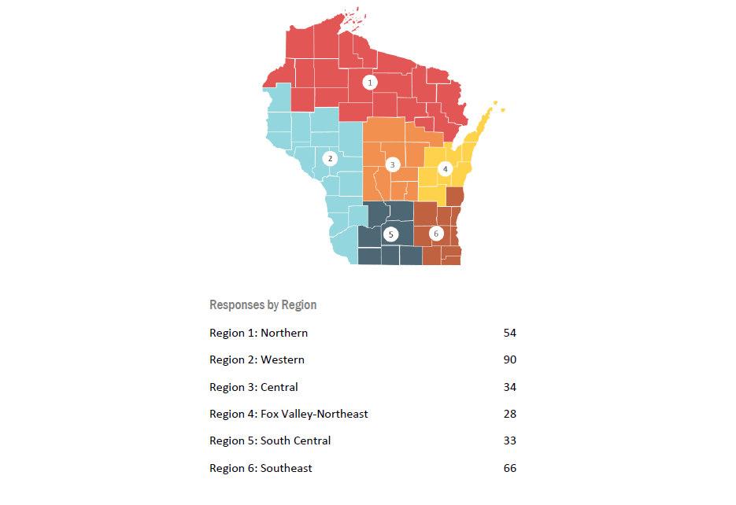
Map of
Survey Regions
*Note: IFLS's region crushed the competition for responses

Slide 6
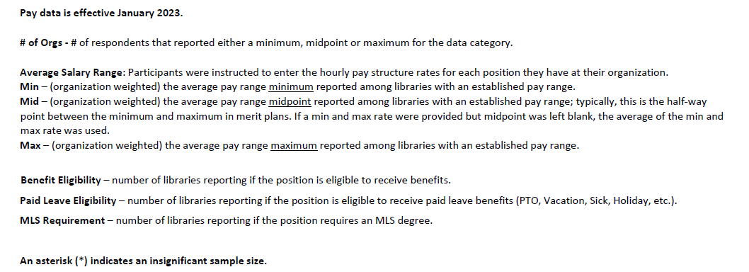
Survey Definitions

Slide 7
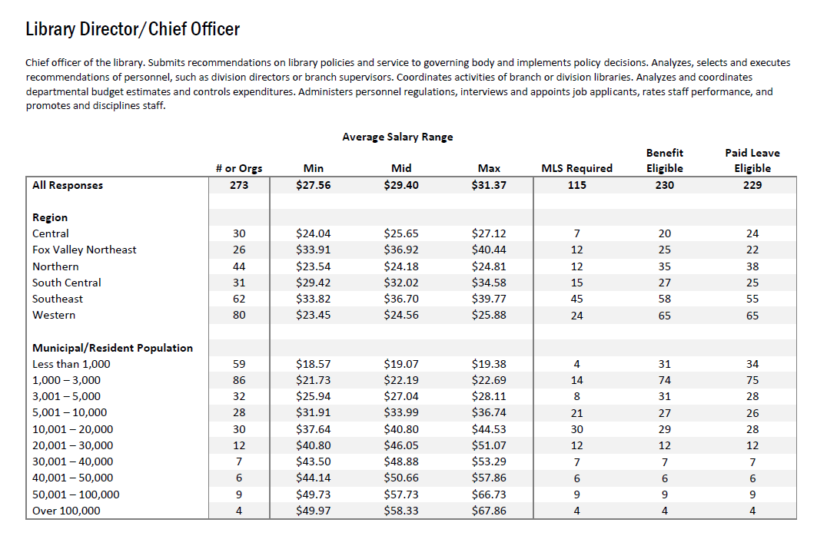
Wage Chart Example

Slide 8

The way to get started is to quit talking and begin doing.
Walt Disney

Slide 9
Matching your position

Slide 10
Position Matching
Step One
Compare your positions to the ones listed in the survey.
Do you have exact matches?
Library Director
Step Two
Look at duties not titles
Do staff work alone? Are they handling all the responsibilities for assisting patrons?
Step Three
Do they have specific responsibilities such as youth service programming?
Step Four
Do they supervise other staff?
Final Step
Which is closer to 70% of the duties most of the time?

Slide 11
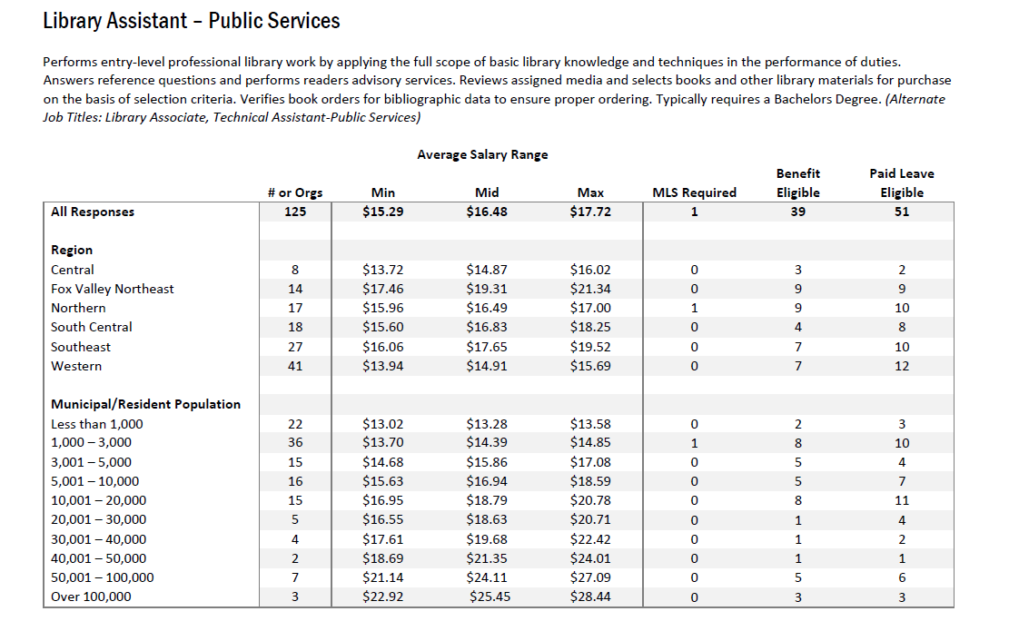
Library Assistant

Slide 12
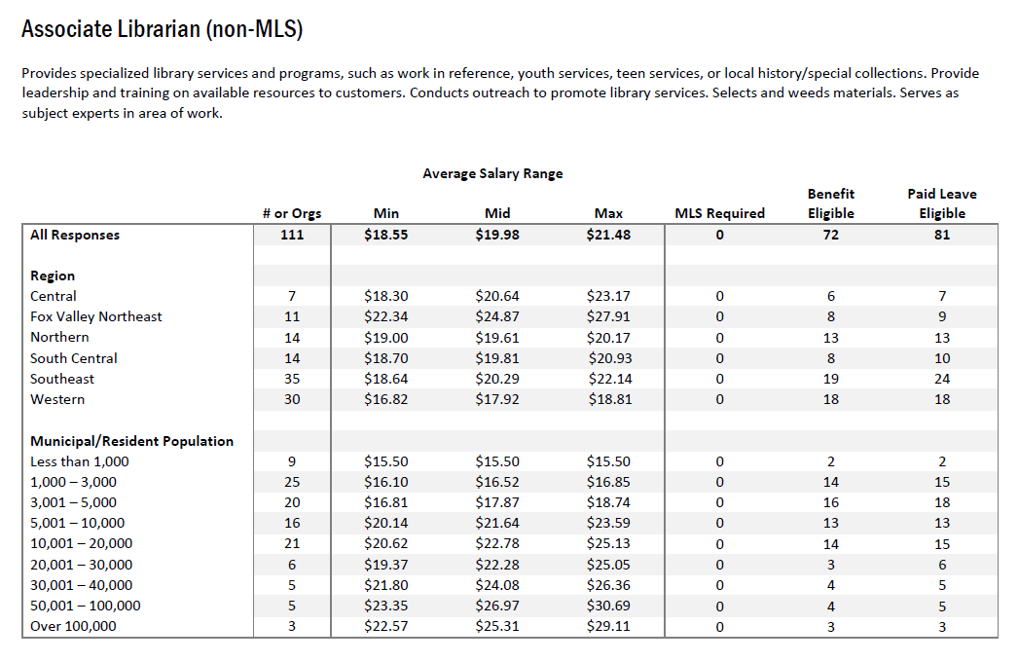
Associate Librarian

Slide 13
Market Comparisons

Slide 14
Considerations
Step One
Which region is your county located in?
Other factors-Twin Cities metro area
Population range—are you close to moving up in category?
Step Two
Libraries traditionally have low wages. Remember these are actual numbers not recommended numbers.
Step Three
Other Employers in the area—
Customer Service such as McDonald’s, Culvers, or Kwik Trip
Library Paraprofessionals at the local school district
Step Four
Other Municipal Employees
Comparable positions
How do library wages seem to fit within the wage scale of your municipalities
Step Five
Use all the data to advocate for a budget increase to support improved compensation
Look at your peers in your area

Slide 15
Advocacy Example
Breezy Pines Library -- Municipal Population 1,100
  Library Assistant currently makes $12.00 per hour
  Library Director seeks to increase wage for the Library Assistant
    Reviews positions on pages 24 and 45
      Determines the current library position best matches Associate Librarian (non-MLS) since they are responsible for youth services
      Based on Population Size
        Minimum Average Wage is $16.10
        Midpoint Average is $16.52
      Based on Region -- Western
        Minimum Average Wages is $16.82
        Midpoint Average is $17.92

Slide 16
Advocacy Example
  Additional Comparisons to Use
    Rolling Meadows School District is advertising a Library Media Specialist position at $15 per hour
    KT is advertising minimum starting wage at $15 per hour
    Recent library job postings in the area
  Library Director recommends a 2-year plan to increase the wage from $12 to $16.
    2024 Wage to $14
    2025 Wage to $16
  Making your case
    Use the style/language your municipal board likes to use
    Need to have connections with board members prior to budget time
    What is the overall increase to the budget for the position
    Create a chart to show comparisons
    Talk about retention and training time
      Disruption in programming

Slide 17
Find the information
The complete report and toolkit are available on the System and Resource Library Administrators’ Association of Wisconsin (SRLAAW) website: srlaaw.org/compensation-study
Links to this webinar and slide deck will be available on the IFLS website.

Slide 18



Q&A
IFLS is here to assist you.

Slide 19
Contact
John Thompson
Katelyn Noack
Reb Kilde
Advocacy Support
Leah Langby
Youth Services

Slide 20




Thank you

