Slide 1
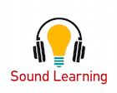
Audio Publishers Association
Sound Learning Webinar 9/28/16
Speakers: Michele Cobb, Mary Burkey & Sharon Grover
SoundLearningAPA.org

Slide 2
Today’s Presenters
Michele Lee Cobb Executive Director, Audio Publishers Association
Mary Burkey
National Board Certified Teacher-Librarian, Columbus, OH
Audiobooks for Youth: A Practical Guide to Sound Literature (ALA Editions)
“Voices In My Head” columnist & Audiobooker blogger for Booklist
Sharon Grover Youth Services and Audiobook Literacy Consultant, Janesville, WI
Listening to Learn: Audiobooks Supporting Literacy (ALA Editions)
Contributing Editor, AudioFile Magazine

Slide 3
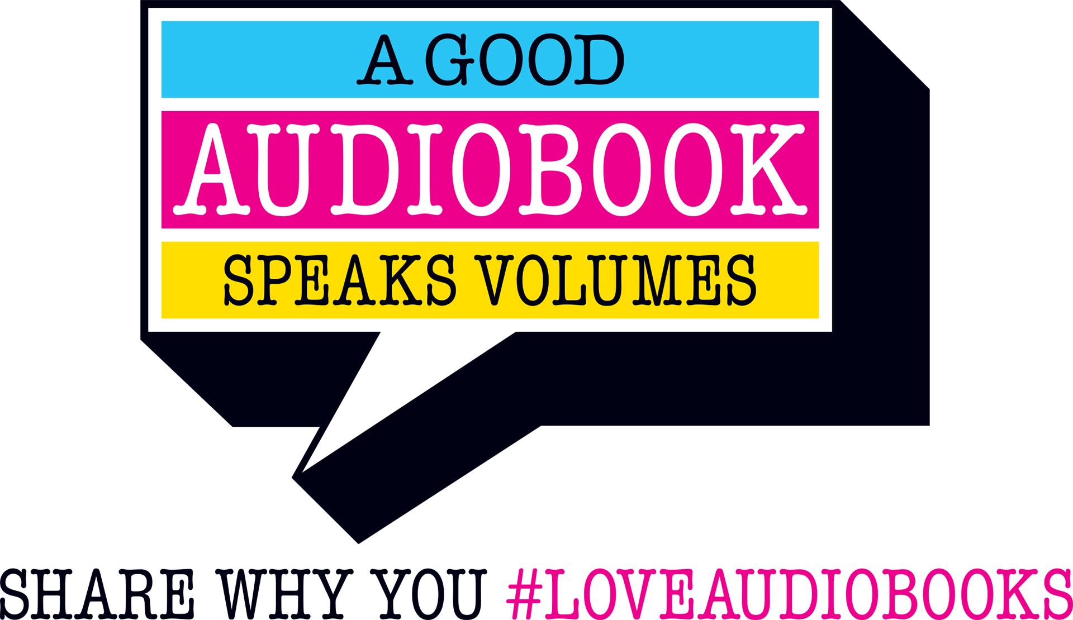
https://www.audiopub.org/audiobook-community-for-listeners

Slide 4
Sales Growth
20.7% Sales Increase
24.1% Units Increase
Audio Publishers Association Sales Survey 2015

Slide 5
Titles Published
Year Titles
2015 35,574
2014 25,787
2013 24,755
2012 16,309
2011 7,237
Audio Publishers Association Sales Surveys 2011 - 2015

Slide 6
Library Usage
86% of respondents saw an increase in the usage of digital audiobooks in the past year
Library Journal Audiobook Survey 2016

Slide 7
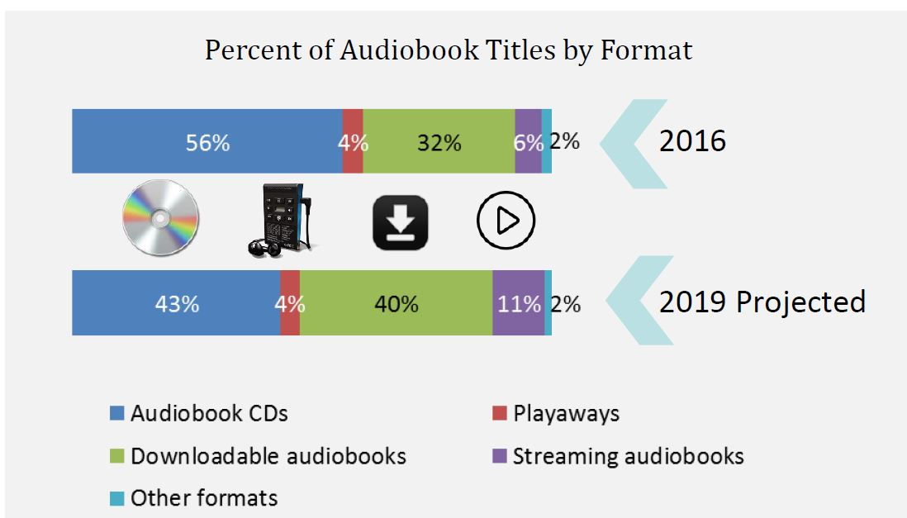
What the Future Holds
Library Journal Audiobook Survey 2016

Slide 8
Literacy Benefits
Oral Language and Listening: Key Standards
Print, Share, and Link to Sound Learning’s Overview on the Benefits of Audiobooks
SoundLearningAPA.org
Notes:
Listening and Oral language standards have long formed the basis for language instruction, currently 46 states recognize the Common Core Standards.
Speaking and Listening: Flexible communication and collaboration
Including but not limited to skills necessary for formal presentations, the Speaking and Listening standards require students to develop a range of broadly useful oral communication and interpersonal skills. Students must learn to work together, express and listen carefully to ideas, integrate information from oral, visual, quantitative, and media sources, evaluate what they hear, use media and visual displays strategically to help achieve communicative purposes, and adapt speech to context and task.
Language: Conventions, effective use, and vocabulary
The Language standards include the essential “rules” of standard written and spoken English, but they also approach language as a matter of craft and informed choice among alternatives. The vocabulary standards focus on understanding words and phrases, their relationships, and their nuances and on acquiring new vocabulary, particularly general academic and domain-specific words and phrases.

Slide 9
21st Century Literacy
“As society and technology change, so does literacy. Because technology has increased the intensity and complexity of literate environments, the 21st century demands that a literate person possess a wide range of abilities and competencies, many literacies.”
“Integration of multiple modes of communication and expression can enhance or transform the meaning of the work.” National Council of Teachers of English, 2013
SoundLearningAPA.org
Notes:
NCTE’s declarations concerning the broadest definitions of multi-modal literacies (http://www.ncte.org/governance/MultimodalLiteracies):
• Integration of multiple modes of communication and expression can enhance or transform the meaning of the work beyond illustration or decoration.
What this means for teaching:
o It is the interplay of meaning-making systems (alphabetic, oral, visual, etc.) that teachers and students should strive to study and produce. “Multiple ways of knowing” (Short & Harste) also include art, music, movement, and drama, which should not be considered curricular luxuries.
o All modes of communication are codependent. Each affects the nature of the content of the other and the overall rhetorical impact of the communication event itself.
• Young children practice multi-modal literacies naturally and spontaneously. They easily combine and move between drama, art, text, music, speech, sound, physical movement, animation/gaming, etc.

Slide 10
Transmedia Literacy
https://www.audiopub.org/transmedia-literacy

Slide 11
Addressing the Word Gap
Linguistically “poor” first graders know the meanings of about 5,000 words, while linguistically “rich” first graders have a vocabulary of about 20,000 words, a 400% “word gap”. Moats, 2001
Oral language: Sound units lead to grammar which becomes meaning within context that expands vocabulary, creating a rich literacy experience.
SoundLearningAPA.org
Notes:
For pre-readers & beginning readers
This word gap in Kindergarten can result in a 5.2 year difference in reading ability by age 13
Phonology: The basic sound units of language (phonemes)
 Morphology: Units of meaning within words; the way words
are formed (morphemes)
 Syntax: Phrase and sentence structure – what makes sense
(grammar)
 Semantics: The way language conveys meaning
 Pragmatics: Appropriate word choice and use in context to
communicate effectively
 Orthography: Spelling patterns
 Vocabulary: Knowledge of the meaning and pronunciation of
words (lexicon)
- L.C. Moats (2000) and Burns, Griffin, & Snow (1999)

Slide 12
Fluency: The Flow of Language
“Fluent readers can read text with speed, accuracy, and proper expression. It is generally acknowledged that fluency is a critical component of skilled reading. Nevertheless, it is often neglected in classroom instruction.” National Reading Panel, 2014
https://www.nichd.nih.gov/publications/pubs/nrp/Pages/findings.aspx
SoundLearningAPA.org
Notes:
https://www.nichd.nih.gov/publications/pubs/nrp/Pages/findings.aspx
Teachers need to know that word recognition accuracy
is not the end point of reading instruction. Fluency
represents a level of expertise beyond word recognition
accuracy, and reading comprehension may be aided by
fluency. Skilled readers read words accurately, rapidly
and efficiently. Children who do not develop reading
fluency, no matter how bright they are, will continue to
read slowly and with great effort.
Fluency of a nationally representative sample of 4th
graders and found 44% of students to be disfluent even
with grade-level stories that the students had read under
supportive testing conditions. Moreover, that study
found a close relationship between fluency and reading
comprehension. Students who are low in fluency may
have difficulty getting the meaning of what they read.
Given this, it is not surprising that the National Research
Council report, Preventing Reading Difficulties in Young
Children (Snow, Burns, & Griffin, 1998), states
“Adequate progress in learning to read English (or any
alphabetic language) beyond the initial level depends on
sufficient practice in reading to achieve fluency with
different texts” (p. 223)
Especially critical for ELL students

Slide 13
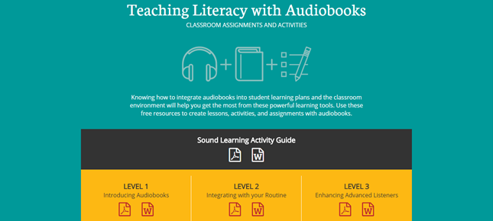
Lesson Plans for Any Audiobook, Any Age
SoundLearningAPA.org
Notes:
Sound Learning offers lessons & activities that can be used with any audiobook for any audience, by any educator. Ptintable PDFs can be sued as-is, or adapt the Word documents to your needs. Look for expanded teaching tools as Sound Learning develops.

Slide 14
For Educators, Librarians & Parents Teaching Literacy with Audiobooks
Level 1 - Includes Two Activity Guides
What’s Your Listening Style / Active Listening
Level 2 - Listening Log
Literary Elements through Listening
Level 3 - Advanced Listening Log
Listening Comprehension and Critical Analysis
SoundLearningAPA.org

Slide 15
Ready, Set, Listen!
Great Audiobooks for Every Grade Level
SoundLearningAPA.org
Notes:
Some offerings from Sound Learning’s extensive lists for collection-building in school or public libraries
Each title is fully annotated and has an audio clip so you can hear a sample of these wonderful audiobooks for yourself
The titles we’re featuring in today’s webinar highlight the diversity of culture that can be found in the best audiobook productions
There’s a great deal of necessary conversation about the need for more diversity in children’s and young adult books
We Need Diverse Books
Audiobooks can supply an authentic cultural listening experience for children and teens
Illustrations in read-alongs
Accurate pronunciation of non-English names and words

Slide 16
Read-Alongs for Early Literacy
“The single most important activity for building the knowledge required for eventual success in reading is reading aloud to children.” Becoming a Nation of Readers
Picture book read-alongs offer exactly that -- they read aloud to children.
Picture books help children acquire both print and visual literacy skills.
SoundLearningAPA.org
Notes:
Let’s start with our earliest learners
Pre-readers learn that the squiggles on the page represent the words they are hearing, that (in English) words are read from left to right.
Beginning readers recognize that sentences are read with inflection and are set apart by capitalization and punctuation.
Children can “read” the illustrations to help describe the details in the text.

Slide 17
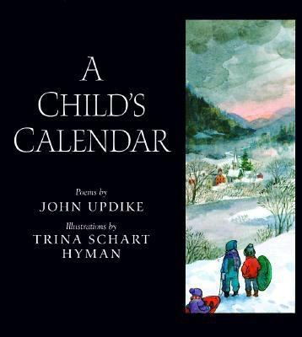
Live Oak Media
SoundLearningAPA.org
Notes:
12 child-centered poems -- one for each month of the year
observations of natural world as well as celebrations throughout the year
perfect for early childhood lessons on changing seasons
features a multiracial cast living somewhere in rural New England
elegant, understated narrated by Updike is perfect foil for Hyman’s saturated watercolor paintings
quiet, even pacing

Slide 18
Read-Alouds for Primary Grades
Original folk tales score big hits with young listeners, their teachers, and families
Family listening provides opportunities for shared experiences and conversation
“It can be a wonderful bonding experience, giving the parent a chance to talk about ideas and values at the same time that it increases an understanding of story and a love for books.” Bruce Coville, Listening to Literacy
SoundLearningAPA.org
Notes:
Remember, children can listen and comprehend 2-3 grade levels beyond their reading ability
Stop that audiobook and talk about what’s happening

Slide 19
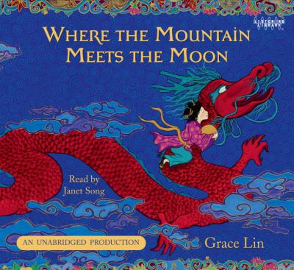
Listening Library
SoundLearningAPA.org
Notes:
In the shadow of Fruitless Mountain, Minli and her parents struggle to make ends meet, barely having enough to eat.
When Minli spends one of her last two coins on a supposedly magical goldfish, her mother rails against the foolishness put into the girl’s head by her tale-spinning father.
Aided by the truly magical fish, Minli sets out to save her family’s fortunes by going to visit the elusive Old Man of the Moon.
Chinese American author Grace Lin has created this original story that echoes ancient Chinese folk tales
Janet Song’s narration wraps this enchanting story with a hint of Chinese inflection and cadence, adding to the authentic listening experience

Slide 20
Expanding the View for Middle Grade Listeners
The transition to adolescence marks changes in reading and listening habits.
With increased roles in activities, students often turn to mobile listening connections
The use of smartphones and MP3 players helps adolescent listeners keep up with their “reading”
SoundLearningAPA.org
Notes:
Listening to audiobooks can fulfill school assignments for English language arts, history and social studies, and science
Reading for pleasure can often decrease beginning in middle school and audiobooks help check that decline by providing the opportunity for kids to “read with their ears” while doing many of the other activities that keep them busy

Slide 21
Full Cast Audio
SoundLearningAPA.org
Notes:
It’s particularly important to help inward-focused middle schoolers understand the diversity of a global society
In this excellent offering from Full Cast Audio’s Duets line, the terrors of South Sudan are highlighted by the plight of two children living years apart.
David Baker's ability to replicate the cadence and intonation of young Salva's speech gives heartrending immediacy to the boy's awful predicament—caught in the crosshairs of a dreadful war
Cynthia Bishop quietly portrays Nya, a young Sudanese girl who, 10 years after Salva's ordeal, still struggles each day to carry enough water back to her village so her family can survive.
The author's note and Salva's own words at the end will give further understanding to the difficulties faced by other young people around the world in their efforts to survive.

Slide 22
Exploring What Life Holds in Store for High School Students
They’re poised on the brink of a brave, and sometimes frightening, new world
Books can help them make sense of what is going on in this unfamiliar landscape
SoundLearningAPA.org
Notes:
They’re mature one moment and childish the next
They have broad interests and they’re busy all the time
With school, sports, extracurricular activities, and jobs
They tell us they often use audiobooks to “read” assignments while doing chores, working out, or riding to their various events
They squeeze in pleasure reading by listening while getting ready for school or while waiting to fall asleep at night

Slide 23
Simon & Schuster/Recorded Books
SoundLearningAPA.org
Notes:
Teens often find it difficult to determine their place in the world
Ari and Dante are polar opposites who develop a close friendship over the course of one summer
On the cusp of manhood, Ari struggles to find his identity and his family situation doesn’t help
His Vietnam-veteran father finds it too difficult to communicate
His incarcerated older brother has vanished from the family’s conversation
Dante knows who he is, but that doesn’t make his life any easier
Lin-Manuel Miranda mines the depths of this powerful, poetic, multi-award winner
Giving and authentic voice to the Mexican American community that plays such an important role in this journey of self-discovery

Slide 24
Audio Formats Interpret Adult Books for Teen Listeners
Teen readers often move between young adult literature and books targeted to an adult audience
Teachers, librarians, and parents are wise to offer a wide range of materials to these unpredictable reader/listeners
SoundLearningAPA.org
Notes:
Teen reader/listeners enjoy a far-ranging variety of reading material
Remember that they’re mature one day and childish the next
When working with this age group, be sure you have adult titles to book talk and recommend
Sound Learning is unique in offering a list of prominent audiobook titles especially for teen listeners

Slide 25
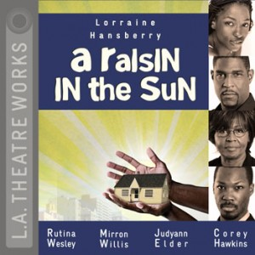
L.A. Theatre Works
SoundLearningAPA.org
Notes:
Classics and plays make up a large part of high school reading lists
They can be difficult for students, especially struggling readers or English Language Learners, to understand
Here’s where the audio format interpretation can be so valuable
For example, students might find it difficult to appreciate the full emotional impact of Hansberry’s mid-twentieth century glimpse into an African American family’s attempt to make better lives for themselves with a life insurance bonanza
This stellar full-cast production smooths the path into a time and culture that may not be familiar
Each cast member’s vocal creation of character allows listeners to realize the driving force behind every individual in this iconic play

Slide 26
Public Libraries & Audiobooks
Partners in Promoting Listening & Learning
SoundLearningAPA.org
Notes:
Sound Learning offers many ways to focus attention on “reading with your ears.”
Check out annual lists of award-winning titles from the American Library Association and the Audio Publishers Association
The APA guide for libraries is chock-full of terrific tips for increasing audiobook circulation in the public library by, among other things,
Hosting workshops for parents, teachers, and students on how audiobooks can increase literacy skills
Letting your local schools know that your library’s audiobook collection (usually larger than those in most schools) are available for students and teachers to borrow
Displaying audiobooks prominently with other library materials
Making audiobooks part of your readers advisory repertoire

Slide 27
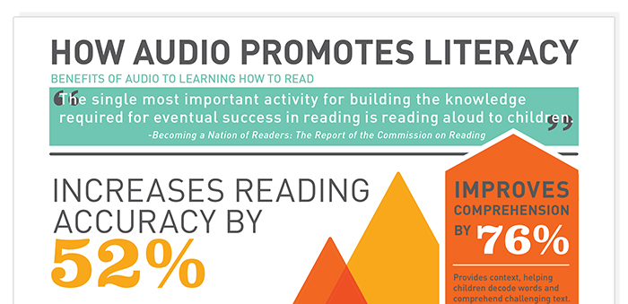
Research & More
Connecting the Dots
SoundLearningAPA.org
Notes:
The Sound Learning bibliography provides the information you need to market your audiobook collection to library patrons and school colleagues
Articles and additional information will help you connect your community to the latest and best research linking audiobooks to literacy skills

Slide 28
Q&A
SoundLearningAPA.org

