Slide 1


Revised 2024
IFLS Library System
John Thompson | System Director
Public Library Board Trustees
Roles & Responsibilites
Slide Design by Katelyn Dubiel

Slide 2

Overview
Managing the Library’s Money
Managing the Facility
01
04
Working with Municipalities & Advocacy
02
05
Strategic Planning
03
Library Personnel
06
Library Law & Legal

Slide 3
Roles & Responsibilities of Library Boards

Slide 4

View the Trustee Essentials: A Handbook for Wisconsin Public Library Trustees
Roles & Responsibilities
According to Wis. Stat. § 43, the library board...
  Has exclusive control of all library expenditures
  Supervises the administration of the library and appoints a library director
  Prescribes the duties and compensation of all library employees
  Purchases the library site and erects the library building, when authorized
  Has exclusive control of all lands, buildings, money, and property acquired or leased by the municipality for library purposes

Slide 5
Roles & Responsibilities
Library Board Job Description
  Legal responsibility for overall library operations rests in the library board, not individual trustees. This includes the board president.
  Prepare for and attend regular board meetings
  Actively participate in discussions and decision making; yet allow for others to share their opinions
  Hire, supervise, and evaluate the library director
  Work with the municipality to obtain sufficient library funding and salaries/benefits for library staff
  Review and approve library policies

Slide 6
Roles & Responsibilities
Library Board Job Description cont.
  Review and update board bylaws
  Assist with development and approval of long-range plan
  Advocate for the library
  Attend library conferences, workshops and other library education opportunities
  Work as a team member in support of library service
  Provide input on community needs and interest to help guide library services to meet community needs

Slide 7
Board Meetings
Roles & Responsibilities
Library Board | Library Director
Review Agenda before the meeting | Prepare agenda with the Board President
Study background materials | Prepare background materials
Know Open Meetings Law | Know Open Meetings Law
Support Board Decisions | Support Board Decisions
Approve Minutes | Maintain meeting records
Be an active participant | Act as technical advisor

Slide 8
Planning
Roles & Responsibilities
Library Board | Library Director
Approve Long Range Plan | Draft Long Range Plan
Provide input on community needs | Solicit community input

Slide 9
Personnel
Roles & Responsibilities
Library Board | Library Director
Hires and evaluates the Director | Hires and evaluates the Staff
Approves Wages | Recommends Wages
Approves job descriptions | Recommends job descriptions

Slide 10
Budget
Roles & Responsibilities
Library Board | Library Director
Approves the budget | Drafts the budget
Approves expenditures | Expends the budget
Approves the Financial Report | Prepares the Financial Report

Slide 11
Policy
Roles & Responsibilities
Library Board | Library Director
Approves policy | Reviews policy examples/samples and relevant laws prior to drafting policy
Reviews existing policies | Reviews existing policies

Slide 12
Material Selection
Roles & Responsibilities
Library Board | Library Director
Approves the Collection Development Policy | Selects library materials with other staff as appropriate

Slide 13
Advocacy
Roles & Responsibilities
Library Board | Library Director
Supports the library and library issues | Informs the Library Board on library issues and law
Speaks at community groups | Prepares library talking points and speaks at community groups
Writes letters of support
Attends municipal board meetings | Attends municipal board meetings
Respresents the community on the board

Slide 14
Managing the
Library’s Money

Slide 15
Wis. Stat. § 43.58
Managing the Library’s Money
Powers and duties (1)
The library board shall have exclusive control of the expenditure of all moneys collected, donated, or appropriated for the library fund.
Powers and duties (2)(a)
The library board shall audit and approve all expenditures of the public library and forward the bills or vouchers covering the expenditures, setting forth the name of each claimant or payee, the amount of each expenditure...to the appropriate municipal or county financial officer...The appropriate municipal, county, or school district official shall then pay the bill as others are paid.
Note: No further action is required by the municipal board for payment by the municipality

Slide 16
Managing the Library’s Money
Board Responsibilities
Review and approval of all library expenditures
Review and monitoring of monthly financial statements
Develop policies for handling gifts and donations
Accurate financial reporting
Review and approval of the budget draft
  Does it provide adequate support for the library service goals?
  Does it provide competitive wages to retain and recruit staff?

Slide 17
Developing the Library Budget
Managing the Library’s Money
Budget Development Process
Done by the Director and Key Staff
Determine what the library hopes to accomplish next year
Determine financial resources needed for the next budget year
Draft budget document (director and key staff)
Present draft budget to the Library Board for their approval

Slide 18
Developing the Library Budget
Managing the Library’s Money
Sources of Funding & Revenue*
Municipal Appropriation
County (ACT 150 & ACT 420)
Fines & Fees
Lost items/cards; room rental; copier; printing fees; etc.
Funds Carried Forward
  Municipal/County appropriations or fines and fees revenue unspent from the prior year
  These funds should be budgeted for expenditure and not used to create a reserve
  Under normal circumstances these funds should be nothing or very minimal
State Funds or Federal Funds (if any)
*These are public funds that MUST be deposited with the municipality

Slide 19
County Funds
Managing the Library’s Money
County Funds
The library receives county funds from:
Home County (ACT 150)
Adjacent Counties (ACT 420)
County funds are appropriated based on the cost per circulation to residents of that county who live in a municipality that does not have a library
The cost per circulation is determined by dividing the total operating expenditures (minus federal funds) by the total circulation

Slide 20
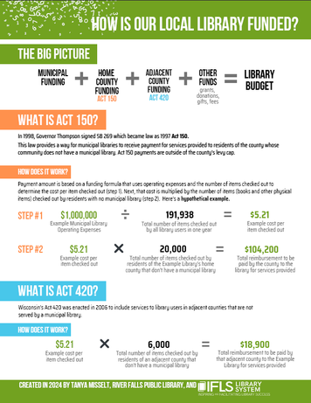


Check Out this One Page Flier from IFLS!
Example of Cost Per Circulation
Operating Expenses
$437,908
Total Circulation
130,597
Cost per Circ
$3.35

Slide 21
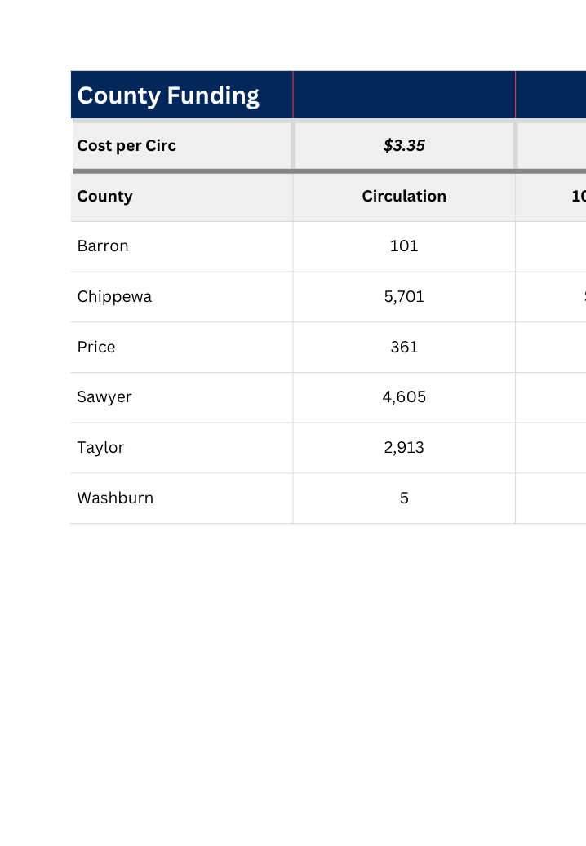
Example of Cost Per Circulation
Circulation to nonresidents (municipalities without libraries)

Slide 22
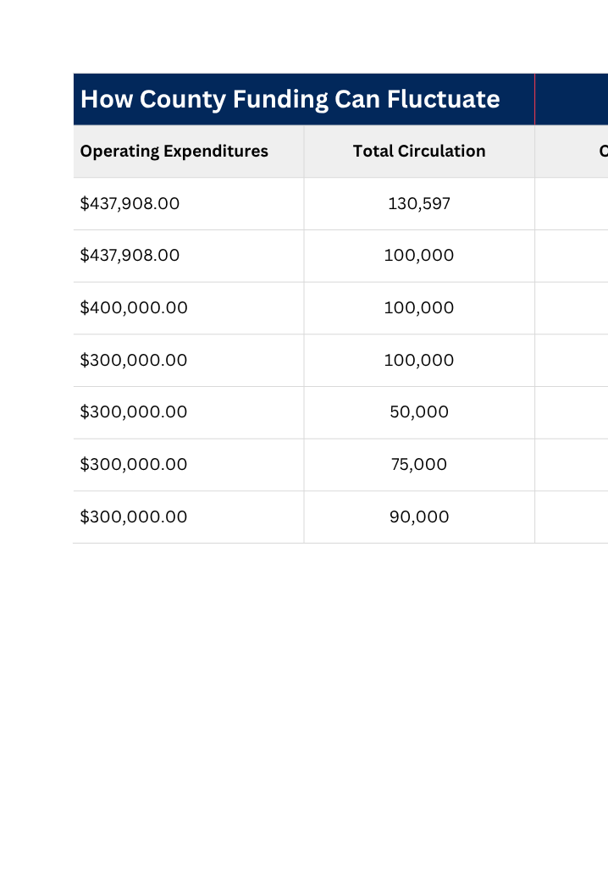
Example of Cost Per Circulation

Slide 23
County Funds
Managing the Library’s Money
Does the county payment to a municipality for library services provided to non-residents of the municipality go to the library or the municipality’s general fund?
To the library!
See League of Wisconsin Municipalities Libraries FAQ #2

Slide 24
Fines & Fees
Managing the Library’s Money
Fines & Fees
Public libraries are prohibited from charging for basic library services
Fees can be charged for...
  Lost library cards
  Lost or damaged materials
  Photocopies/Printing
  Meeting Room Rental
  Equipment Rental

Slide 25
Funds Carried Forward
Managing the Library’s Money
Funds Carried Forward/Surplus Funds
2006 Attorney General Opinion - in matter involving the City of Washburn
“The authority of the library board to make budget transfers within the library budget and to carry forward unexpended funds is expressly granted under section 43.58(1), which provides that ‘[t]he library board shall have exclusive control of the expenditure of all moneys collected, donated or appropriated for the library fund...’”
“While a library board may not maintain unexpended monies as “generic ‘funds on hand,’” Barth, 108 Wis. 2d at 520, it may (indeed must) re-budget such funds for the following year.”

Slide 26
Developing the Library Budget
Managing the Library’s Money
Sources of Funding & Revenue
Donations (if amount is known)

Slide 27
Donations & Gift Funds
Managing the Library’s Money
Donations & Gift Funds
The gift/donation policy should establish:
  The purpose for the use of those funds
  Where the funds will be deposited
    Wis. Stat. § 43.58(7)
    Public Depository
    Municipality
    Community Foundation
  Who can sign checks from those funds
    Two signatures are recommended

Slide 28
Developing the Library Budget
Managing the Library’s Money
Expenditures
Salaries & Wages
Benefits
Materials
  Books
  Periodicals
  Video Materials
  Audio Materials
  E-Content
  Software
Contracted Services
Continuing Education
Programming

Slide 29
Developing the Library Budget
Managing the Library’s Money
Expenditures cont.
Telecommunications
Utilities
Equipment Repair
Supplies
Computer/Equipment Replacement
Building Maintenance

Slide 30
Developing the Library Budget
Managing the Library’s Money
Budget is Approved by the Board
Present and advocate for the budget with funding bodies
Create a clear budget with little or no library jargon
Charts and other comparison information
Use the format required by the municipality
Present the budget to the appropriate committees and boards
Thank the committee and boards for their consideration of the library budget

Slide 31
Advocacy
Managing the Library’s Money
Advocacy
“Because public libraries have a unique place in local government, their needs may not be as readily understood by government officials as those of other units of government, and a greater effort is needed to tell the library story.”
Trustee Essentials #13

Slide 32
Library Board &
Library Personnel

Slide 33
Library Personnel
Library Board
Library Director
  Hires & Evaluates the Director
  Establishes duties, compensation, and personnel policies for all library staff
  Provides financial support as part of the library budget for director and staff professional membership, conferences, continuing education, and travel.
  Hires & Supervises Staff
  Recommends changes to personnel policies and wages
  Consults with the Library Board on important personnel issues

Slide 34
Director Evaluation
Library Personnel
Why Evaluate the Director
Provide formal feedback on job performance
Set goals for the upcoming year
Informs the board about operation and performance of the library
Establish record of performance, in the event discipline or termination is needed
Review job description for possible revision

Slide 35
Director Evaluation
Library Personnel
Who Should Evaluate the Director
Library Board or a personnel committee, depending on the size of the board
Entire Library Board should review, discuss, and approve final written evaluation
Can solicit formal written comments from staff with the knowledge of the director.*
*Note: The director was hired to manage daily operations of the library, and the chain of command should flow from the staff > director > board.
Exception: Staff may come to the board for issues of harassment involving the director.

Slide 36
Director Evaluation
Library Personnel
What is the Basis for Evaluation
Written job description
List of goals and objectives developed the preceding year and agreed upon by the director and the board
Success of library in carrying out services and the director’s contribution to this success
Unanticipated factors or events that occurred during the prior year

Slide 37
Director Evaluation
Library Personnel
How to Conduct the Evaluation
Director should complete a self-evaluation form which may or may not be part of a permanent record
It helps to compare the view of the director and the board for areas of agreement and resolve disagreements
Board President and Director should sign the written evaluation after it has been reviewed and discussed with the director

Slide 38
Director Evaluation
Library Personnel
How to Conduct the Evaluation
Use a consistent evaluation to provide benchmarks/targets from year to year
3 or 6-month evaluation for new directors
Yearly after 12 months

Slide 39
Director Evaluation
Library Personnel
Where to Conduct the Evaluation
Personnel evaluations should be conducted in closed session per Wis. Stat. § 19.85

Slide 40
Director Evaluation
Library Personnel
How to Care for a Library Director
Provide a consistent message to the Director
Treat them professionally
Support continuing education needs
Advocate for library needs
Compensate fairly
Check in with them regularly
Say “Thank You”

Slide 41
Facility Management

Slide 42
Facility Management
Wis. Stat. § 43.58 Powers and Duties
(1) The library board shall have exclusive control of the expenditure of all moneys collected, donated or appropriated for the library fund, and the purchase of a site and the erection of the library building whenever authorized. The library board also shall have exclusive charge, control and custody of all lands, buildings, money, and other property devised, bequeathed, given or granted to, or otherwise acquired or leased by, the municipality for library purposes.
Wis. Stat. § 43.58(1)

Slide 43
Facility Management
Preventative Maintenance
Safety Issues
Library Image

Slide 44
Policy Development

Slide 45
Policy Development
Director (and staff) develops recommended policies
Board discusses, reviews/revises, and approves policies on a regular basis
Policies need to be reasonable and legal
Here are four tests of a legally defensible policy:
Test #1 - Policies must comply with current statutes and case law
Test #2 - Policies must be reasonable (and all penalities must be reasonable)
Test #3 - Policies must be clear, not ambiguous or vague
Test #4 - Policies must be applies without discrimination

Slide 46
Library Planning

Slide 47
Library Planning
Help Guide Budget & Service Decisions
  Staffing
  Programming
  Collection
Different Models Ask the Same Basic Questions
  Where are we?
  Where do we want to go?
  How do we get there?
  Are we getting there?

Slide 48
Library Planning
Long range planning should be a partnership between the library board and staff to ensure that both groups share common goals and mission for their community.
Library plan addresses community needs.
Share the plan with the stakeholders and community
Does the budget support the plan of service?

Slide 49
Library Planning
Is the library offering the right mix of programming?
Does current programming meet the needs of the community?
  Board can provide input as representative of the community
  Director develops or delegates responsibility for program development
Is there sufficient staff and funding to provide the needed programming?
Are the programs attracting current and new users to the library?
Is programming a priority?

Slide 50
Gathering Information
Library Planning
Statistical Data
  Demographics
  Usage
Community Feedback
  Surveys
  Focus Groups
  Community Discussions
Staffing
Does the Library have enough staff?
Are staff assigned to the proper duties?
Does the library staff skill set match the needs of the library?

Slide 51
Advocacy and Working with Municipalities

Slide 52
Advocacy
One of the major responsibilities of a public library trustee is to act as an advocate for the library.
A library advocate is someone who understands the value and importance of public library service and who communicates that value and importance to the community, government leaders, and other decision-makers
Your primary function as a library advocate will be to provide clear, accurate, and timely information on library issues to people who need it in order to make sound decisions on those issues.

Slide 53
Advocacy
As an advocate, you can influence decision-makers by:
Speaking to civic groups about library needs and issues
Talking to friends about the library, its role in the community, and its needs
Writing letters to the editor of the local newspaper
Testifying at local and state budget hearings
Talking and writing to state and federal legislators about the needs of the library
Contributing to a library newsletter that is sent to decision-makers

Slide 54
Working with Municipalities
Responsibilities of Municipal Government
Tips for Working with the Municipal Board
Appoint the Library Board
Pay library bills once approved by the Library Board
Appropriate funds for the library budget
Have a library presence at a variety of meetings, not just at budget time
Provide regular updates and an annual report about the library
Get to know the elected and appointed officials and their views/issues
Invite candidates to debate at the library
Hold open house for officials
Create common agenda with the municipality

Slide 55
Library Law

Slide 56
Library Law
Chapter 43
Wis. Stat. about
Public Libraries
Opening Meeting Law
Public Record
Law
Americans
with
Disabilities Act
And More...

Slide 57
Wisconsin Statutes
Library Law
Wisconsin Statutes
Wisconsin Statutes are available in print and online in PDF format
(https://docs.legis.wisconsin.gov/statutes/prefaces/toc)
A searchable database is also available
(https://docs.legis.wisconsin.gov/search)

Slide 58
Wisconsin Statutes
Library Law
Chapter 43
Sections pertaining to Public Libraries:
  § 43.09 Certificates and Standards
    Director Certification Authority (Rules in Administrative Code)
  § 43.11 County Library Planning Committees
    Outlines the creation of a county wide library planning committee and their duties and powers
  § 43.12 County Payment for Library Services
    More commonly known as ACT 150; details formula for home county and adjacent counties

Slide 59
Wisconsin Statutes
Library Law
Chapter 43
  § 43.15 Standards for Public Library Systems
    Population of System
    Financial Support
    Organization
    Membership Requirements (County and Local Library)
  § 43.16 Resource Libraries
    Usually the largest library in the system
  § 43.17 Public Library Systems; General Provisions
    Board Organization / Terms
    Advisory Committee

Slide 60
Wisconsin Statutes
Library Law
Chapter 43
  § 43.18 Withdrawal, Abolition and Expulsion
    Outlines leaving a system
  § 43.19 Federated Public Library Systems
    Size of board in multi-county systems
      IFLS has a 20-member board
  § 43.57 Consolidated County Libraries and County Library Services
  § 43.60 County Tax
    Outlines exempting from County Library tax for municipality with a library

Slide 61
Wisconsin Statutes
Library Law
Chapter 43
  § 43.30 Public Library Records (known as library privacy law)
    Library Records are Confidential
      Custodial Parent for children under the age of 16
      Release to other libraries
      Judicial court order is needed
      Surveillance Device release for Law Enforcement if library requests or criminal conduct within the library
      Use of collection agencies or law enforcement is allowable with Library Board approved policy

Slide 62
Wisconsin Statutes
Library Law
Chapter 43
  § 43.52 Municipal Libraries
    Outlines starting a new library
    Libraries shall free for use
    Opinion by Library Division on feasibility
  § 43.53 Joint Libraries
    Created by 2 or more municipalities or county and one or more municipalities
    Agreement Requirements
      Fiscal Agent
      Distribution of assests if dissolved
      Library Board establishment

Slide 63
Wisconsin Statutes
Library Law
Chapter 43
  § 43.54 Municipal Library Board Composition
    Appointed by the Mayor, Village President or Town Chairperson with approval of the governing body
    Composition
      School District Administrator or their designee
      Only one governing board member (not required)
      Up to two may be residents of other municipalities
    Terms
      Three year staggered
        No term limit by library board (can be set by the municipal board)
    Size
      Village - 5 (can be increased to 7)
      2nd or 3rd Class City - 9
      4th Class City - 7

Slide 64
Wisconsin Statutes
Library Law
Chapter 43
  § 43.58 Powers and Duties
    Exclusive control of all library expenditures
    Supervising the administration of the library and appointing a library director
    Prescribing the duties and compensation of all library employees
    Purchasing of a library site and the erection of the library building when authorized
    Exclusive control of all lands, buildings, money, and property acquired or leased by the municipality for library purposes.

Slide 65
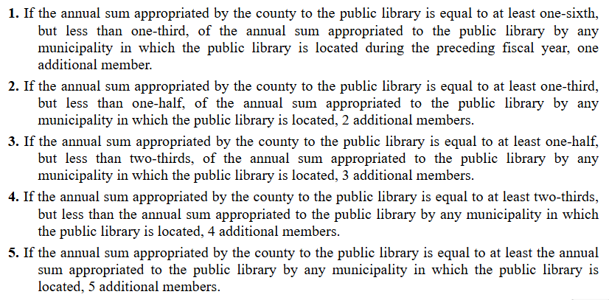
Wisconsin Statutes
Library Law
Chapter 43
  § 43.60 County Appointments to Municipal and Joint Public Library Boards

Slide 66
Open Meeting Law
Library Law
Open Meeting Law
  Contained in Chapter 19, General Duties of Public Officials
  Meeting notice posted at least 24 hours in advance
    Provided to the official local newspaper
    Any news organization requesting a copy
    Posted in one or more public locations (usually three locations)
      Library
      City/Village/Town Hall
  Agenda
    Time, Date, Place and all subjects to be discussed or acted upon
    Can’t use “other business” as an agenda item

Slide 67
Open Meeting Law
Library Law
Open Meeting Law
  Held in an accessible location
  Provide accommodations if requested
  Minutes must be kept and made available to the public
  Meeting Quorum
    Majority of the board
    Purpose to engage in business
    Email quorum
      Can’t make decisions or influence decisions via email
      Use email to distribute agenda; not for discussion or poll
    Negative Quorum
      If ⅔ vote is needed then a block of members that meet/discuss outside of a meeting to oppose an item

Slide 68
Open Meeting Law
Library Law
Open Meeting Law
  Closed Session - Limited reasons to go into closed session
    Wis. Stat. § 19.85
      Consider employment, promotion, compensation, or performance evaluation data of any employee*
      Consider dismissal, demotion, or discipline of an employee
        Employee can request discussion be done in open session
      Deliberate the purchase of public property
      Confer with legal counsel
      There are additional reasons, but most often do not apply to libraries
*For specific individuals, not for general wage increases,
compensation, or personnel policies

Slide 69
Open Meeting Law
Library Law
Open Meeting Law
  Agenda must indicate any contemplated closed session, subject matter of closed session, and the specific provision
    Example: 19.85(1)(c) Considering employment, compensation, promotion, or performance evaluation data of any public employee over which the governmental body has jurisdiction or exercises responsibility. Conduct Library Director Evaluation
  Process for going into closed session
    Board must first convene in open session
    Announce intention to go into closed session
    Must state the reason for going into closed session
    Requires a motion, second, and roll call to go into closed session

Slide 70
Open Meeting Law
Library Law
Open Meeting Law
  Attendance is limited to board members, necessary staff, and others whose presence is needed
  Discussion in closed sessiont is limited to the stated agenda purpose
  Most, if not all, votes should be taken in open session
  Must notice on the agenda that the board will reconvene in open session
  Legal penalties range from $25 to $300 per violation
  Actions can be voided if the law was violated

Slide 71
Public Records Law
Library Law
Public Records Law
  Must respond to requests
    Don’t have to be written requests
    Can view or receive copies regardless of format
  Personnel Records
    Balance test - public good vs. privacy
    Personal information, such as SSN, can be removed/redacted
  Need a records retention policy
  Staff Email
    Personal emails are not public per recent Supreme Court Ruling
      Schill v Wis. Rapids Sch. Dist., 2010 WI 86. ¶ 137.

Slide 72
Ethics & Conflict of Interest
Library Law
Ethics and Conflict of Interest
  State Law contained in Chapter 19
    Code of Ethics Wis. Stat. § 19.59
  Local ethics ordinances
  Public contracts

Slide 73
Freedom of Speech
Library Law
Freedom of Speech
  Meeting Rooms
    Can a public library’s meeting room policy deny use by religious groups?
      No. By making their meeting room available to local groups, the library has created a “designated public forum” and denial of use by religious groups would constitute a restriction on free speech.
    Policy can include limits on the frequency of meetings, scheduling, and staff availability

Slide 74
Library Law
Americans with Disabilities Act

Slide 75
Americans with Disabilities Act
Services
Website
Programs
Accessible
Sound Amplification
Sign Language Interpreter
Materials
Equipment
Large Print
Close-Captioned Videos
Descriptive Videos
Braille
Assistive Devices for Computers
Larger Screen Monitors
Lighting

Slide 76
Americans with Disabilities Act
Facilities
Building Exterior
Building Interior
Doors
  Automatic opener not required, but must have limited pressure to open
Ramps
  Slope of ramp 1:12
  Landings at the top and change of direction must be 5'x5'
  Handrails if the ramp is longer than 6'
Parking
  Must have one van accessible space
Aisle with 36" minimum
Shelf height no limit except for magazines
  Side reach 54"; front reach 48"
Accessible seating
  5% with minimum of 1
Desk height
  28"-34"
Braille required on permanent signage
Restrooms
  Sink height, turning radius, fixtures

Slide 77
Americans with Disabilities Act
Employment
Review job descriptions for essential job functions
Reasonable accommodation
  Providing or modifying equipment or devices
  Job restructuring
  Part-time or modified work schedules
  Reassignment to a vacant position
  Adjusting or modifying examinations, training materials, or policies
  Providing readers and interpreters
  Making the workplace readily accessible to and usable by people with disabilities

Slide 78
Resources
New Director Orientation Webpage (IFLS)
IFLS Trustee Resource Webpage (IFLS)
Tools and Resources for Public Library Directors and Board Members (DPI)
Trustee Essentials (DPI)
IFLS Policy Resources & Examples (IFLS)
Policy of the Month Club (DPI/Statewide Collaboration)
Wisconsin State Statute Chapter 43 : Libraries
Wisconsin Public Library Standards (DPI, 2018 Edition)

Slide 79
Open Meeting Resources
Wisconsin State Statutes Chapter 19 : General Duties of Public Officials
Wisconsin Trustee Essential #14
Open Meetings (DPI)
Department of Justice Compliance Guide (State of Wisconsin, March 2025 Edition)
League of Wisconsin Municipalities Governing Bodies: Open Meeting Law

Slide 80
Public Records Resources
Trustee Essential #15 (DPI)
Wisconsin’s Public Records Law (DPI)
Records Retention Schedule for Wisconsin Public Libraries
Department of Justice Compliance Guide (State of Wisconsin, June 2025 Edition)
League of Wisconsin Municipalities Public Records FAQ

Slide 81
Ethics Resources
Trustee Essential #16 (DPI)
League of Wisconsin Municipalities FAQ Pecuniary Interest

Slide 82
ADA Resources
Trustee Essential #20 (DPI)
Trustee Essential #21 (DPI)
Disability and Business Technical Assistance Center (DBTAC) (Great Lakes ADA Center)
ADA (US Department of Justice)
The ADA: Your Employment Rights as an Individual with a Disability (EEOC)
Library Services for People with Disabilities (ALA)
Wisconsin Talking Book and Braille Library (DPI)

Slide 83
Employment Resources
Fair Employment Law (State of Wisconsin)
Wisconsin Department of Workforce Development Posters
United States Department of Labor

Slide 84
Questions?
John Thompson
IFLS Library System Director
thompson@ifls.lib.wi.us
715-839-5082 x116
IFLS Staff Contact Webpage

